Slide 1
Machine Learning

Slide 2
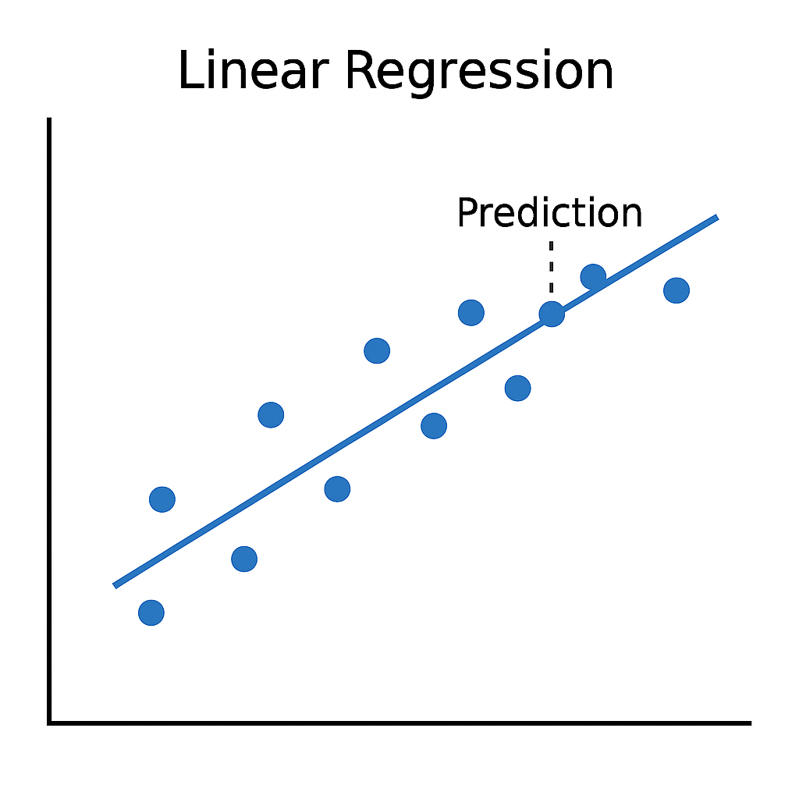
What is machine learning?
Imagine you're collecting data on how temperature changes as pressure changes at constant volume.
Theoretically, there's a linear relationship.
But the data will usually be a bit noisier than that.

Slide 3
What is machine learning?
We can approximate the data using a straight line.
It won't perfectly fit the data, but it captures the main trend.
In the case of a linear function, we can find the "line of best fit" deterministically.

Slide 4
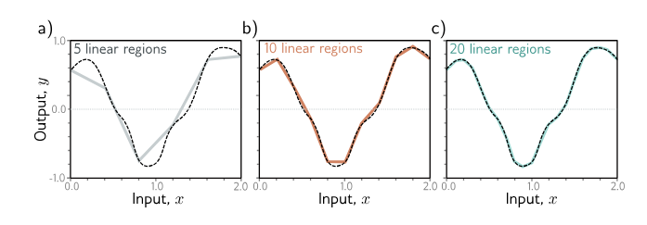
What is machine learning?
Machine learning works similarly – approximation a function using (usually) linear pieces.
Obviously, the functions are much more complex, often many dimensions rather than 1 dimensional curves.
We can't find the approximation deterministically.
Moreover, there is no "best" approximation.
Understanding Deep Learning by Simon Prince, Figure 3.5

Slide 5
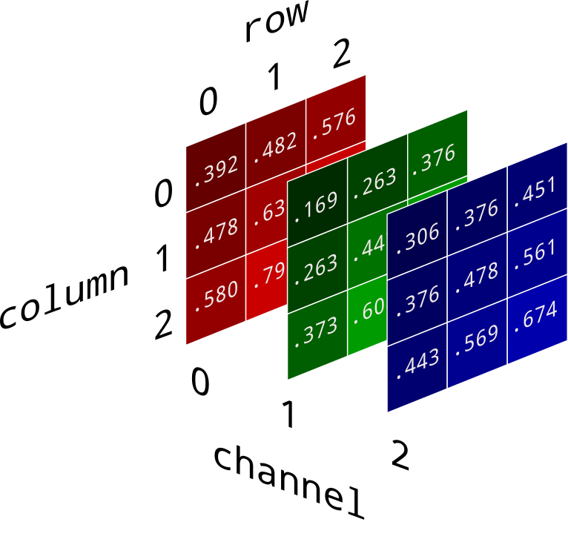
What is machine learning?
How are text generation/image generation/video generation/gaming agents/etc. "just" function approximation?
We can map non-numeric data to a number or vector of numbers.
Text generation -> tokenization (e.g. "a" -> 0, "b" -> 1, …, "z" -> 26)
Image generation -> RGBC + (x, y) position
Video generation -> RGBC + (x, y) position + frame index

Slide 6
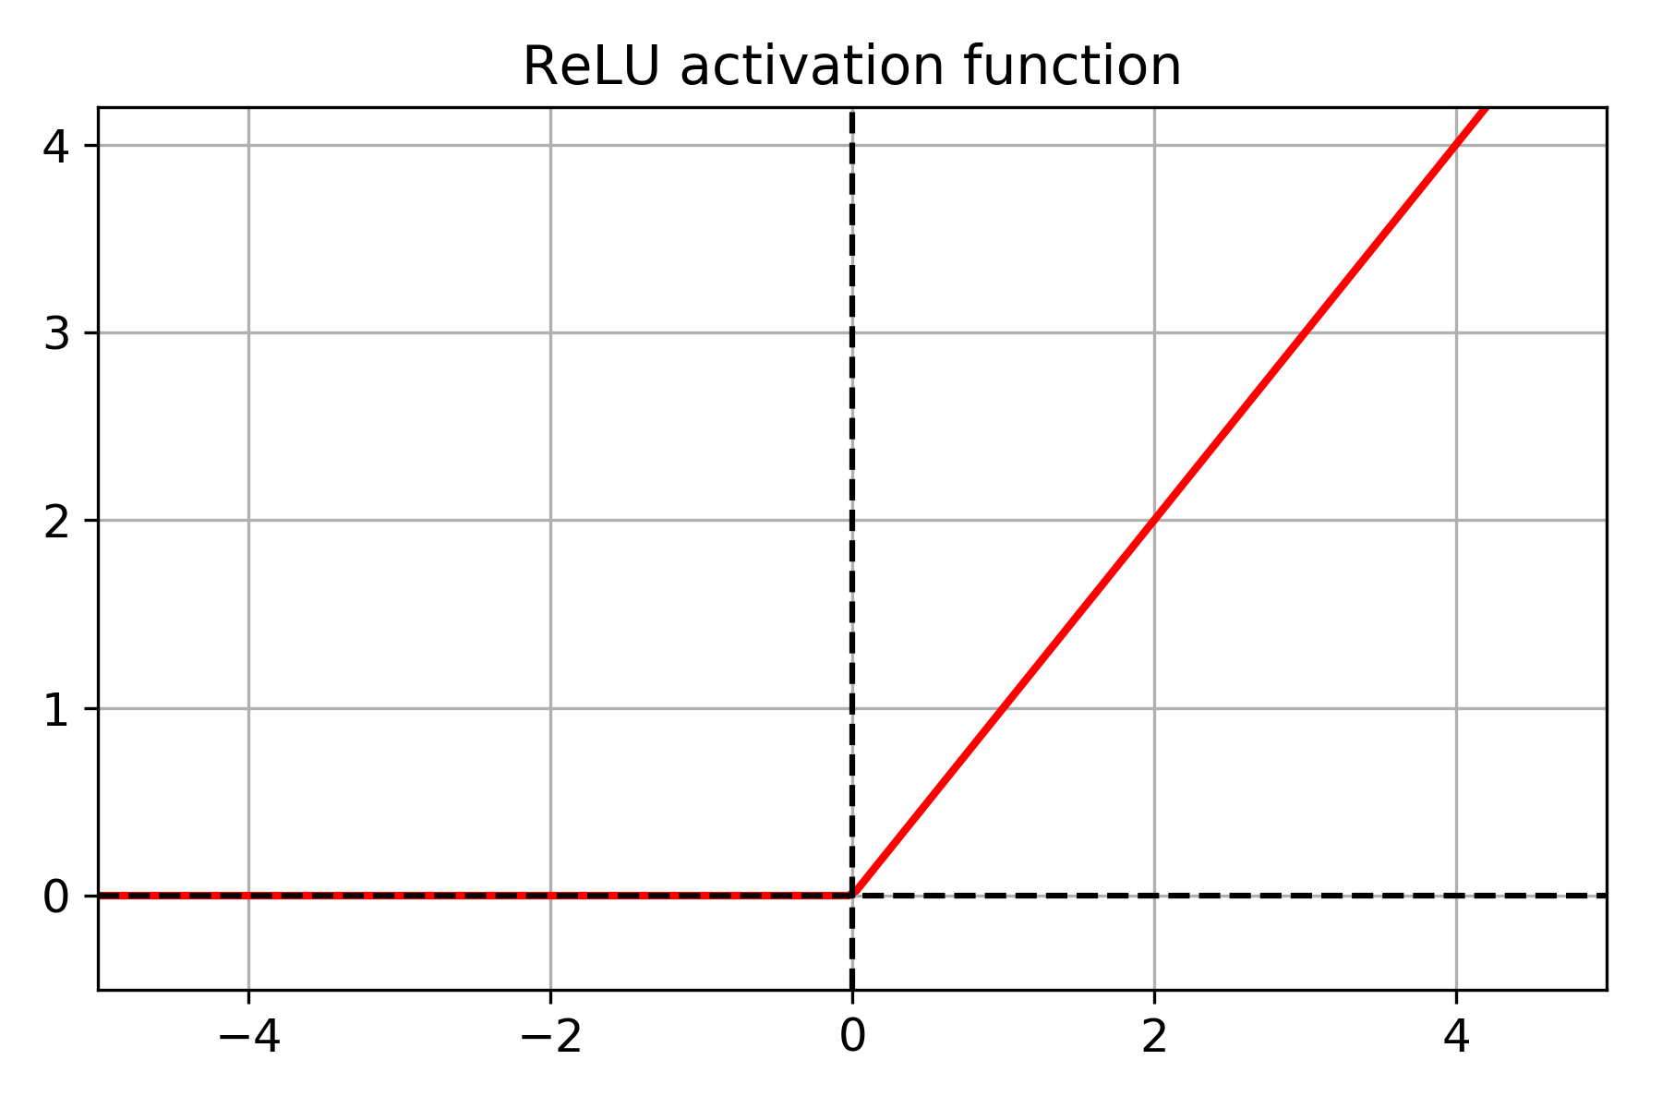
How does machine learning work?
Take your vector of numeric data
Transform it with a linear function (linear layer)
Transform it with a non-linear function(e.g. ReLU)
Repeat the previous two steps many times
Transform from numeric to non-numeric form
Evaluate it against a golden source of truth and update the weights of the linear layers accordingly
Repeat the previous steps until your model is accurate

Slide 7
Why does machine learning work?
Universal Approximation Theorem – Proved that there EXISTS a machine learning model that can approximate any "nicely behaved" function to any degree of accuracy we desire if we add enough layers.
In theory:
No guarantee that our data corresponds to a "nicely behaved" function
No guarantee that we can FIND that approximation.
No guarantee that the approximation can generalize to new data.
In practice:
Data is often "nicely behaved" or can be preprocessed into such.
The approximations we find are often good enough.
The approximations tend to have some good generalization behavior.

Slide 8
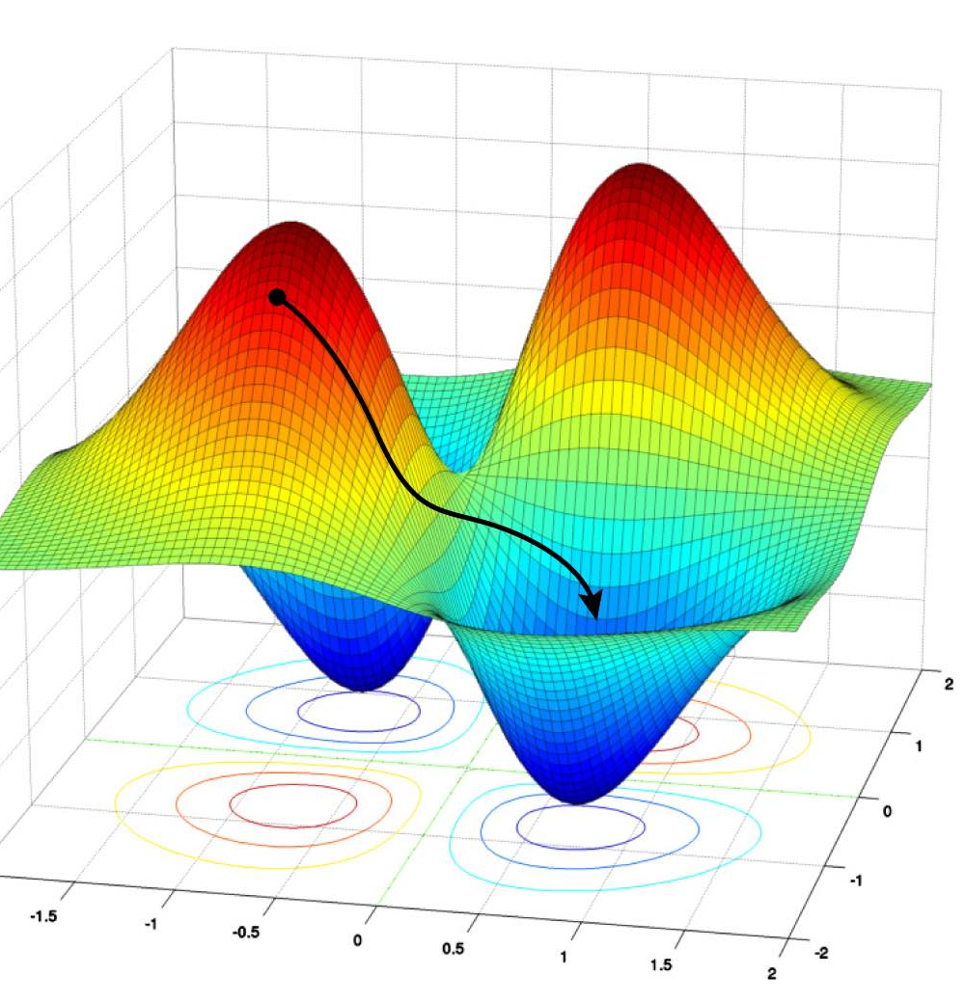
How do we train machine learning models?
Loss function – a function that evaluates the performance of our model based on training data, is a function of the model's parameters
Optimization – We want to find values for the model's parameters that minimize the loss function
Gradient descent – Greedy algorithm for finding those parameters. In "parameter-space", follow the path of greatest decline.
Backpropagation – Allows us to efficiently update the weights of our model using values calculated by gradient descent.

Slide 9
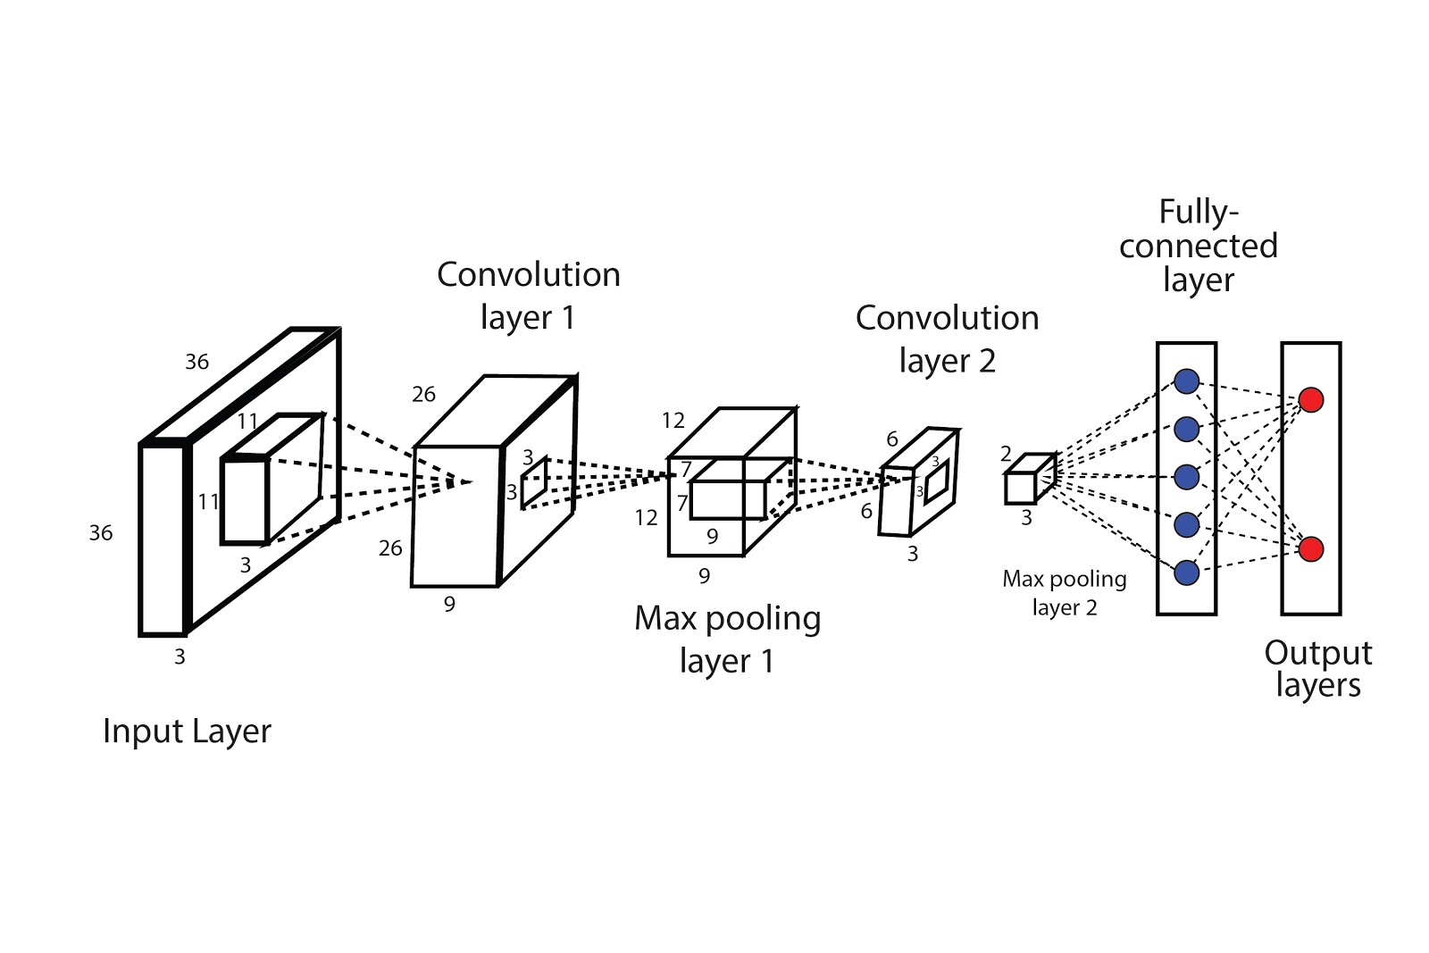
Convolution Neural Networks (CNNs)
Designed specifically for processing images efficiently.
Images are information dense – channel data, positional data, rotation invariance, correlation between colors, etc.
CNN architecture tries to take all this into account to speed up training.
At each step, encodes data from previous layer by decreasing length and width and increasing channels.
At the end, uses a plain linear layer + non-linear layer to produce output prediction.

Slide 10
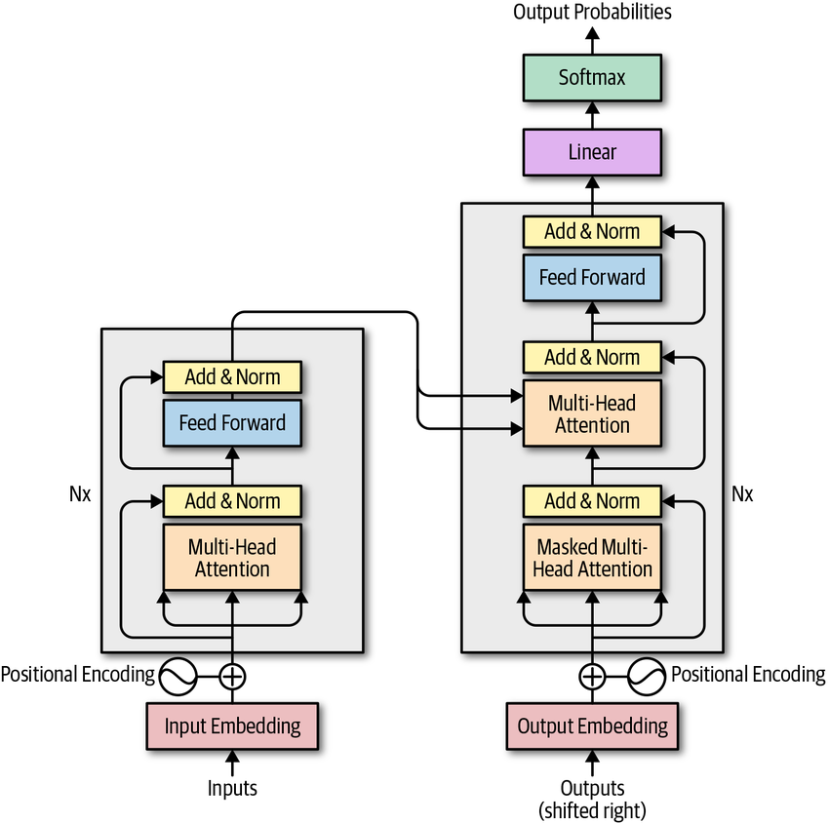
Transformer Architecture
Introduced in the famous "Attention is All You Need" paper
Uses an encoder to process context for variable length sequences
Uses a decoder to generate a target sequence (usually labels or next word prediction)

Slide 11
BERT
Bidirectional Encoder Representations from Transformers
Pre-trained on corpus using masked language modeling and next sentence prediction (NSP)
Masked Language: Take a sentence, mask a word, and ask BERT to predict it. Allows BERT models to understand context from both directions
NSP: Pass in two sentences. Return whether sentence 2 naturally follows sentence 1 (binary classification task). Allows BERT to learn inter-sentence relationships.

Slide 12
Application: PII Eraser
One common task Bayview and other companies are facing is automated PII erasure from documents (e.g. images, PDFs, Word docs).
Main modalities are image and text.
For text, this is a good use-case for a BERT-type model – take in a sequence of words and output a sequence indicating if the word is PII or not.
Then a separate process can erase the PII.

Slide 13

Application: PII Eraser
Image data tends to be harder to parse than textual data – information dense.
We have 2 tasks – segment the text and extract it.
Both can be done using a convolution neural network.

Slide 14
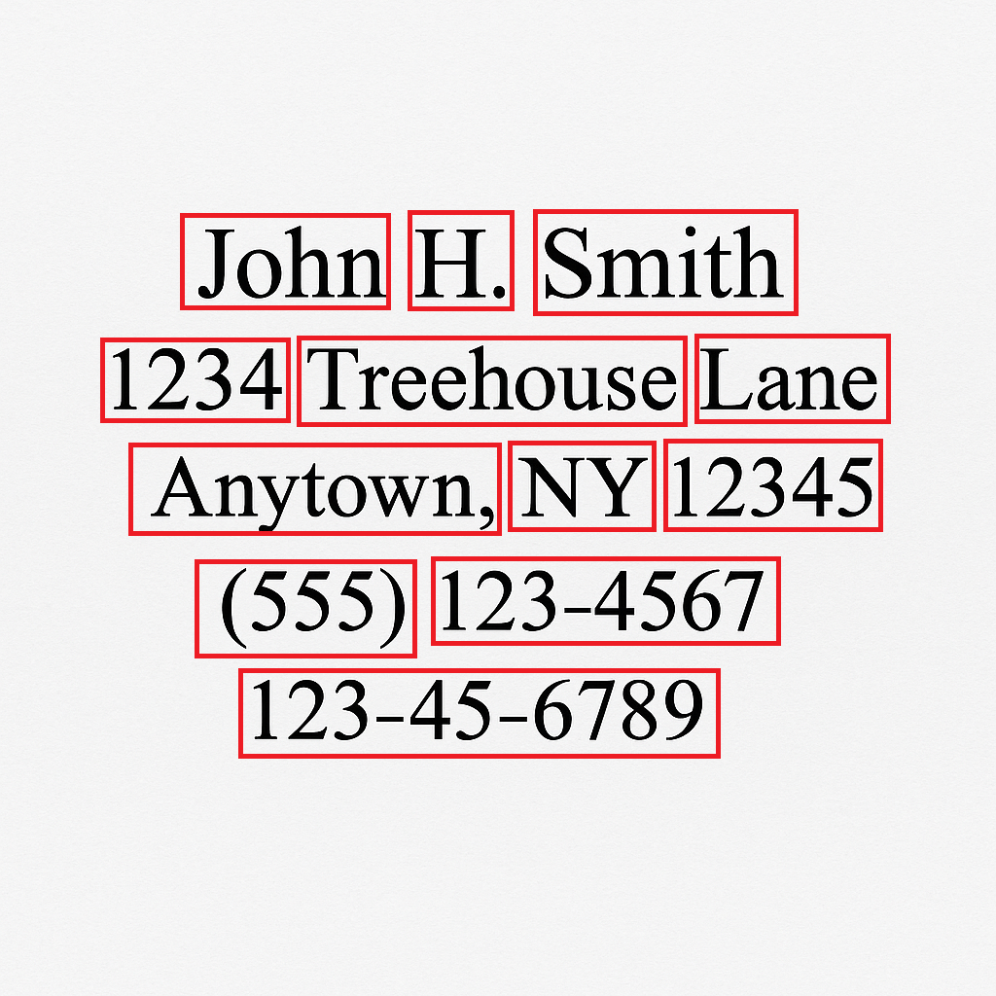
Application: PII Eraser
Once we find our segment-text pairs, we need to identify whether the text is PII or not.
Tokenize the text and pass it to BERT – it can find the PII for us.
Once we know which tokens/words correspond to PII, we can erase them.

Slide 15
Application: PII Eraser
P = PII
NP = Not PII
"My name is Daniel Bhatti" -> "NP NP NP P P"
"Please send me Jane's account number for 11111111" -> "NP NP NP P NP NP NP P"

Slide 16

Application PII Eraser
The segmentation defines the bounding rectangle of the word.
A separate process can erase with a filled in rectangle.
If the image isn't centered properly, we may want the segmentation task to involve a more robust shape.

